Slide 1

VELOCITY/ACCELERATION IN SHM
FISIKA DASAR 1

Slide 2
Velocity in simple harmonic motion (SHM)
Acceleration in simple harmonic motion (SHM)
Overview
Adopted from MIT Course

Slide 3
ENERGY IN SHM
FISIKA DASAR 1

Slide 4
Potential energy (U):
Kinetic energy (K):
Total energy :
Overview
Adopted from MIT Course

Slide 5

Example
Many tall buildings have mass dampers, which are anti-sway devices to prevent them from oscillating in a wind. The device might be a block oscillating at the end of a spring and on a lubricated track. If the building sways, say, eastward, the block also moves eastward but delayed enough so that when it finally moves, the building is then moving back westward. Thus, the motion of the oscillator is out of step with the motion of the building. Suppose the block has mass $m=2.72 x {10}^{5}$ kg and is designed to oscillate at frequency f = 10.0 Hz and with amplitude $x_{m}=$20.0 cm.
What is the total mechanical energy $E$ of the spring-block system?
What is the block’s speed as it passes through the equilibrium point?
Adopted from Halliday & Resnick, Fundamentals of Physics, 10th edition, Wiley

Slide 6






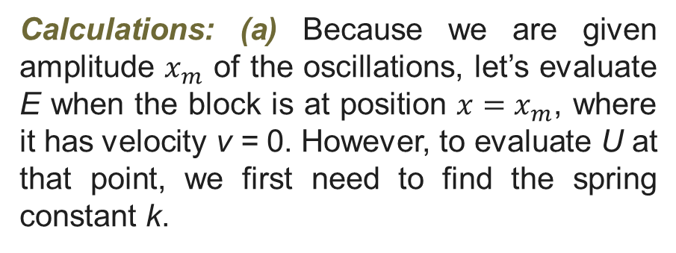

Key Idea
The mechanical energy E (the sum of the kinetic energy $K=\frac{1}{2}mv^{2}$ of the block and the potential energy $U=\frac{1}{2}kx^{2}$ of the spring) is constant throughout the motion of the oscillator. Thus, we can evaluate E at any point during the motion.
$$k=mω^{2}=m(2πf)^{2}$$
$$=(2.72 x {10}^{5} kg)(2π)^{2}(19.0 Hz)^{2}$$
$$=1.073 x 10^{9}N/m$$
We can now evaluate E as
$$E=K+U=\frac{1}{2}mv^{2}+\frac{1}{2}{kx}^{2}$$
Calculations: (a) Because we are given amplitude $x_{m}$ of the oscillations, let’s evaluate E when the block is at position ${x=x}_{m}$, where it has velocity v = 0. However, to evaluate U at that point, we first need to find the spring constant k.
$=0+\frac{1}{2}(1.073 x {10}^{9} N/m$)$(0.20 m)^{2}$
$$=2.147 x {10}^{7} J≈2.1 x {10}^{7}J$$
Adopted from Halliday & Resnick, Fundamentals of Physics, 10th edition, Wiley

Slide 7



Calculations: We want the speed at x = 0, where the potential energy is $U= \frac{1}{2}kx^{2}=0$ and the mechanical energy is entirely kinetic energy. So, we can write
$$E=K+U=\frac{1}{2}mv^{2}+\frac{1}{2}{kx}^{2}$$
$$2.147 x 10^{7}J=\frac{1}{2}(2.72 x 10^{5} kg)v^{2}+0$$
$$v=12.6 m/s$$
Because E is entirely kinetic energy, this is the maximum speed $v_{m}$.
Adopted from Halliday & Resnick, Fundamentals of Physics, 10th edition, Wiley

Slide 8
THANK YOU

